Slide 1


Hii,
Iam Siddhika
Welcome to Power BI Series
Part -40

Slide 2


Today Content
We focus only on the most used and important Dax Functions
I’m soo Excited.
Are you ready guys?
Meet DAX
COMMON FUNCTION CATEGORIES
5.TABLE MANIPULATION FUNCTIONS(FEW MORE)
TOPN
UNION

Slide 3


TOPN
TOPN Returns the top N rows from a table based on a specific expression, optionally ordered by one or more columns.
Let’s see
with example
next
Syntax
TOPN(<N_Value>, <Table>, <OrderBy_Expression>, [<Order>[, <OrderBy_Expression>, [<Order>]]…])
n_value: The number of rows to return.
table: The table from which to return rows.
order_by_expression: The expression to order by.
order: Optional. The sort order. It can be ASC (ascending) or DESC (descending).

Slide 4
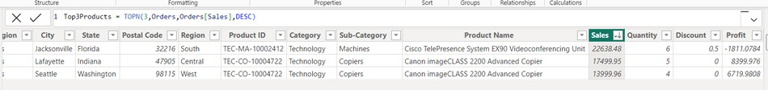

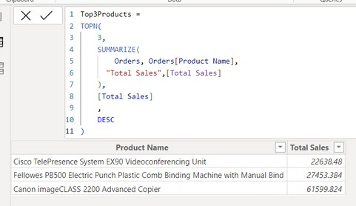

Visual Example for better understanding
Suppose we have the following Orders table:
_{Example} How can you use the TOPN function to retrieve the top 3 orders based
on their sales amount?
Understood?
TOPN creates a table
This function returns the top 3 rows from the Orders table. The rows are ordered by the Sales column in descending order.
Which gives all the columns from the table.
Example
How can you retrieve the top 3 products by sales ? only includes product and sales coulmn
SUMMARIZE function creates a summary table that groups the data by the specified columns and calculates aggregates for each group. In this case, we're grouping by "Product Name" and calculating the total sales for each product.
TOPN function returns the top N rows from a table, sorted by a
specified column. Here, we're returning the top 3 rows, sorted by the "Total Sales" column in descending order.

Slide 5
UNION
Let’s see
UNION: Combines rows from two or more tables into a single table, including all rows and removing any duplicates.
with example
next
Syntax
UNION(<table_expression1>, <table_expression2> [,<table_expression>]…)
There are specific conditions that must be met for the UNION function to work correctly in DAX. Here are the key conditions:
Same Number of Columns: All tables being combined must have the same number of columns.
Compatible Data Types: Corresponding columns in each table must have compatible data types.
(Compatible: Data types that can work together, like numbers with numbers, text with text, dates with dates)
Column Names: Column names in the resulting table will be taken from the first table provided in the UNION function

Slide 6
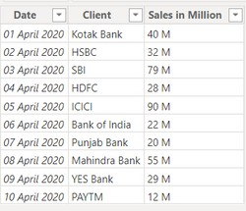
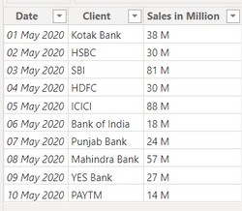
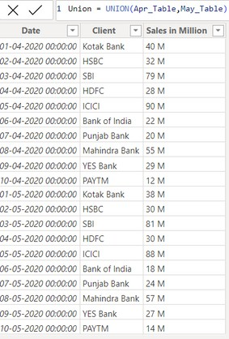
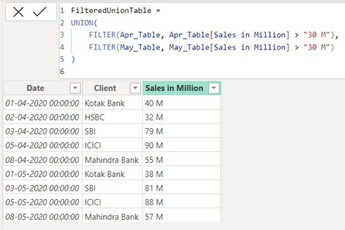
Visual Example for better understanding
Here just i’m taking for example to understand.
Apr_Table
May_Table
Example
Let's create two tables, Apr_Table and May_Table, representing sales data for April and May respectively.
Understood?
How can you use the UNION function to combine Apr_Table and May_Table into a single table?
UNION(Apr_Table, May_Table) function combines all rows from Apr_Table and May_Table into a single table.
How can you use the UNION function to combine Apr_Table and May_Table into a single table that only includes rows where the sales amount is greater than 30M?
FILTER(Apr_Table, Apr_Table[Sales in Million] > 30) - Filters Apr_Table to include only rows where the sales amount is greater than 30M. FILTER(May_Table, May_Table[Sales in Million] > 30) - Filters May_Table to include only rows where the sales amount is greater than 30M.
UNION(...): Combines the filtered rows from both tables into a single table.

Slide 7


Thank you for joining me today to learn about Part -40 of Power BI!
Remember, Learning DAX is key to unlocking the full potential of Power BI for insightful reporting and visualization.
Stay tuned for more insights and tips on Power BI in our next Series.
Follow
Siddhika Shah

